Slide 1
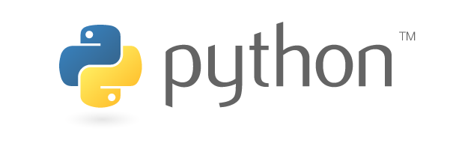
Set up new Python interpreter

Slide 2
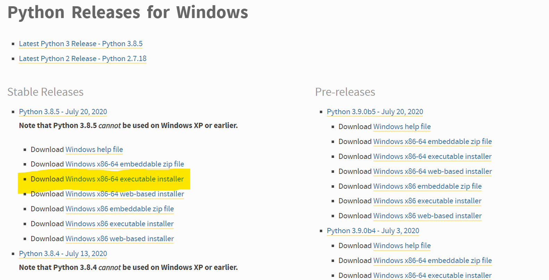
1st step
Download desired Python from https://www.python.org/downloads/windows/
Notice to download the executable distribution as marked

Slide 3
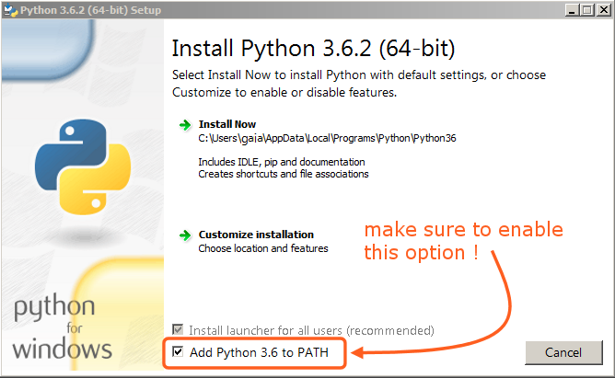
2nd step
Finish installing python and make sure its added to path (very important!)

Slide 4
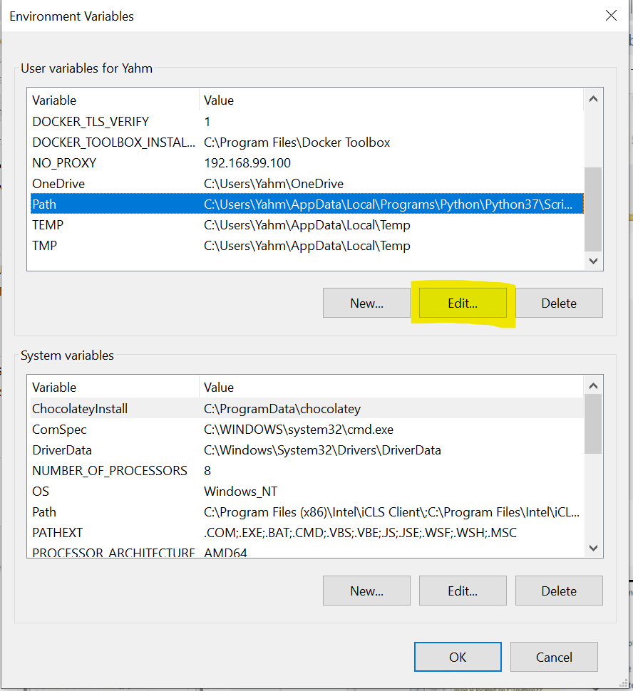
3rd step
Enter ‘Environment Variables‘ and click ‘Edit’
at ‘Path’

Slide 5
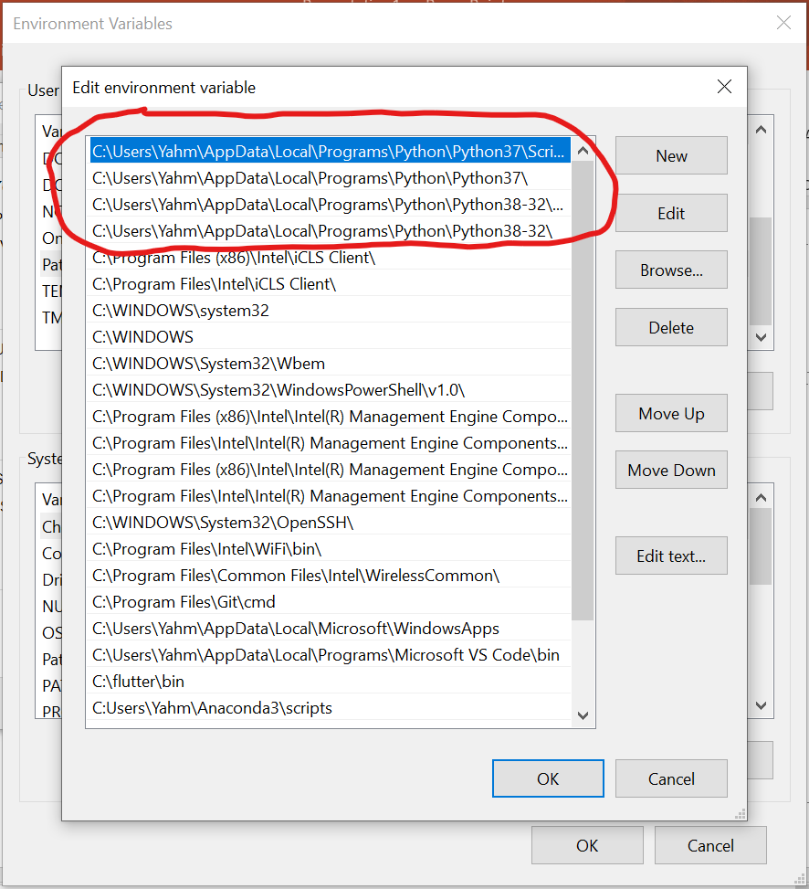
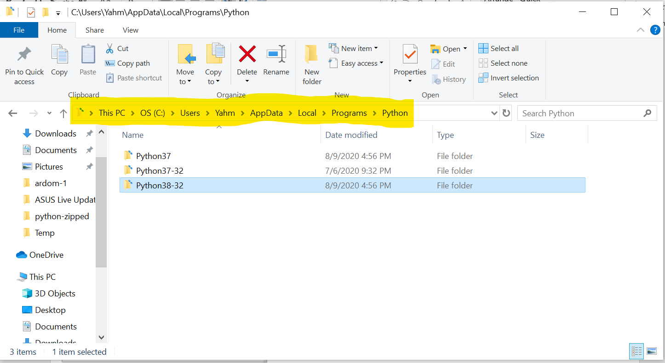
4th step
You will be able to see where Python is installed – open the newly installed Python folder

Slide 6
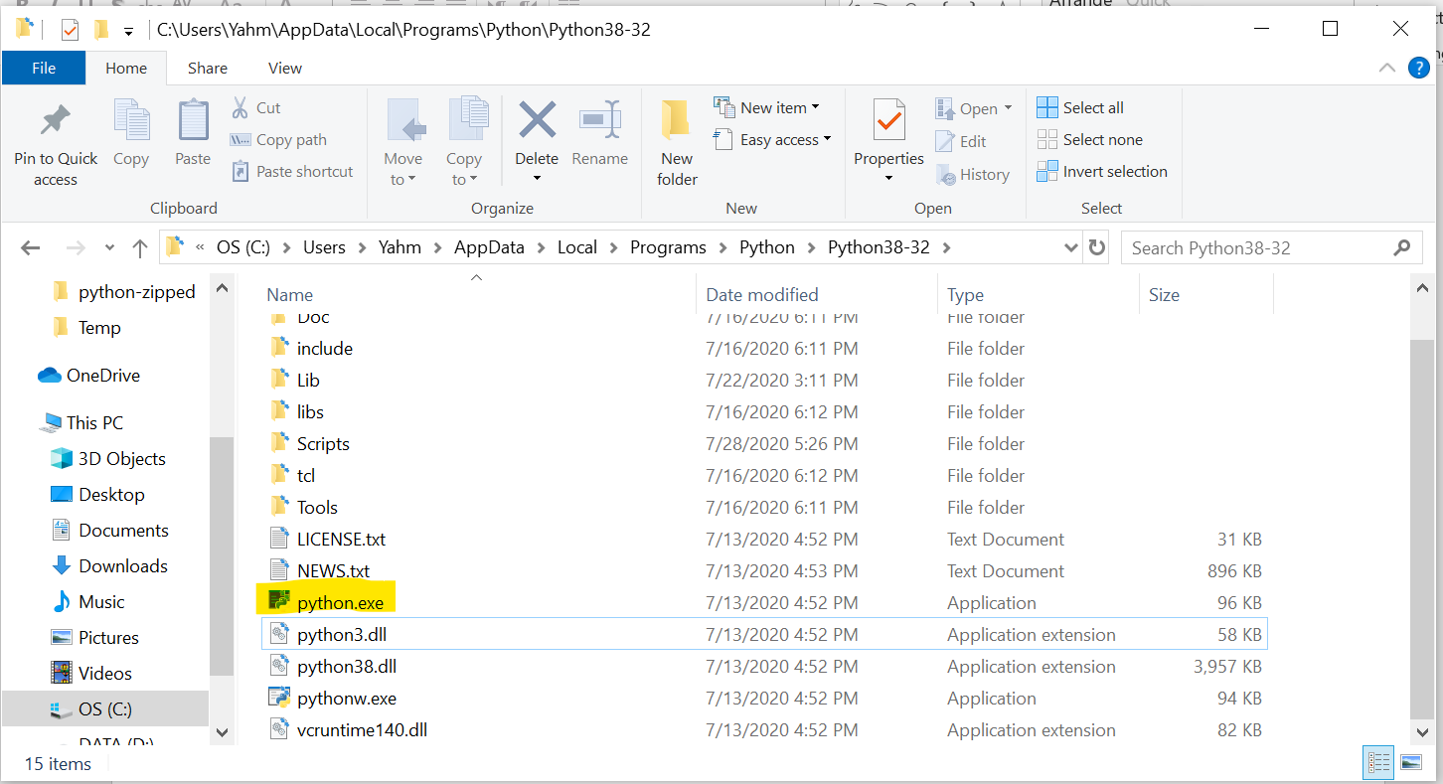
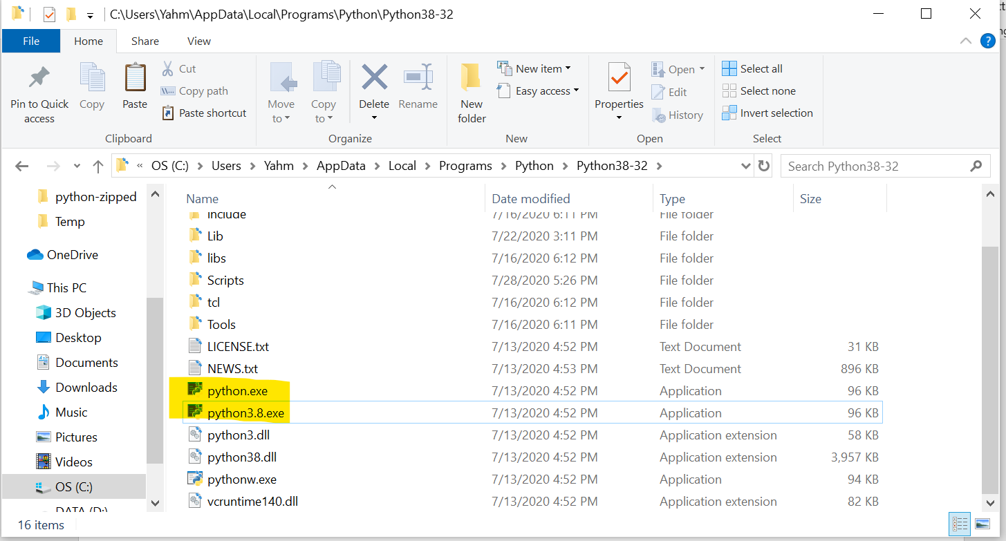
5th step
Duplicate ‘python.exe’ file and rename the new one pythonX.X.exe (python + version number)

Slide 7
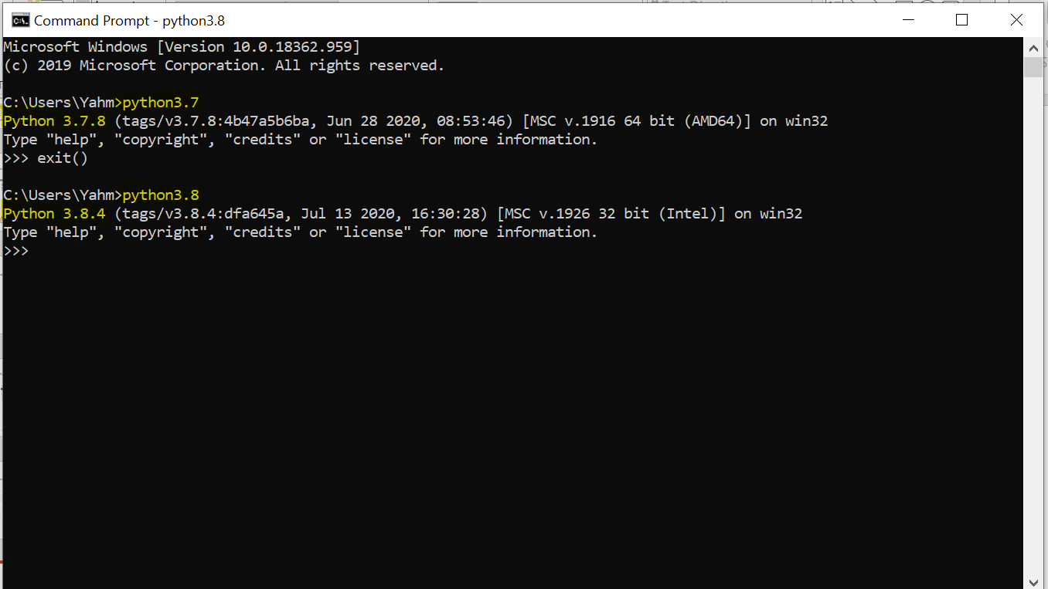
6th step
Access Python as needed!

